Slide 1

SORTING ALGORITHMS ANALYSIS

Slide 2
Table of contents
Introduction to sorting Algorithms
Sorting terminology
Importance of sorting algorithm
Types of sorting algorithm
Merge sort
Quick sort
Heap sort

Slide 3
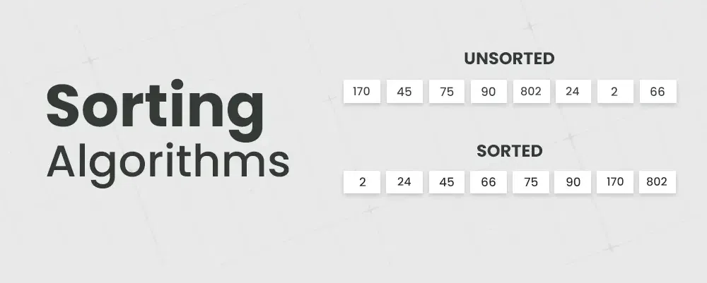
SORTING ALGORITHMS
Sorting is the process of arranging data in a specific order (usually ascending or descending). Elements can be numbers, strings or any other data type.

Slide 4
Sorting Terminologies
Inplace sorting
Internal sorting
External sorting
Stable sorting
Unstable sorting

Slide 5
Sorting terminologies
In-Place Sorting: Uses minimal extra space and sorts elements
directly in the original array (e.g., Selection Sort, Bubble Sort).
Example: Imagine you have a list of numbers: [4, 3, 1, 5, 2]
If you use an in-place sorting algorithm like Bubble Sort, it
will sort the list to [1, 2, 3, 4, 5] by only rearranging
the numbers in the same list.

Slide 6
Internal Sorting: Handles data entirely within memory, making it
suitable for datasets that fit in RAM (e.g., Quick Sort, Heap Sort).
Example:
Suppose you have a list of names [“alice”,”charlie”,”bob”].
list fits in RAM, you can use Quick Sort to sort it
alphabetically [“alice”,”charlie”,”bob”].
External Sorting: Manages large datasets by breaking them into
chunks that fit in memory and then merging them
(e.g., Merge Sort, External Radix Sort).
Example:
Imagine you have a huge file with a list of numbers
that’s too big to fit in RAM. You might first split this file into
smaller parts, sort each part separately, and then combine
these sorted parts into one large, sorted file.

Slide 7
Stable Sorting: Preserves the original order of equal elements in
the sorted output (e.g., Merge Sort, Insertion Sort).
Example: Consider a list of people where each person has a name and
an age:[{name: “alice”, age: 30}, { name: “bob”, age: 30 }] If you
sort this list by age using a stable sort
like Merge Sort, alice will still come before
bob if she was first in the list.
Unstable Sorting: Does not guarantee the preservation of the original
order of equal elements (e.g., Quick Sort, Heap Sort).
Example:
Using the same list of people as before, if you sort
by age using an unstable sort like Quick Sort, alice might
end up after bob even if alice was before bob originally.

Slide 8
IMPORTANCE OF SORTING ALGORITHM
Why does it matter?
Efficient searching: Sorted data allows faster search operations (e.g., binary search).
Data organization: Sorted lists are easier to manage and analyze.
Common use cases: Database queries, financial data, and more.

Slide 9
Basic Sorting Algorithms
Selection Sort
Bubble Sort
Insertion Sort
Merge Sort
Quick Sort
Heap Sort

Slide 11
Introduction to Quick Sort Definition: Quick Sort is a Divide-and-Conquer algorithm.- Basic Idea: It works by selecting a 'pivot' element from the array and partitioning the other elements into two sub-arrays, according to whether they are less than or greater than the pivot.- Key Points: Efficient: Average-case time complexity is O(n log n). - In-place: Requires very little additional space.

Slide 12
How Quick Sort Works: Choose a Pivot: Typically, the first, last, or middle element. 2. Partitioning: - Reorder the array so that elements less than the pivot come before it, and elements greater come after it. - The pivot is now in its final position. 3. Recursively Sort Sub-arrays: - Apply the same process to the sub-arrays on either side of the pivot.

Slide 13
Example Walkthrough:
Given Array: [9, 3, 7, 6, 2, 8, 5]
Step 1: Choose Pivot (e.g., 5)
Step 2: Partition the array: - [3, 2, 5, 9, 7, 6, 8]
Step 3: Recursively apply Quick Sort on sub-arrays:
Left Sub-array: [3, 2] - Right Sub-array: [9, 7, 6, 8]
Final Sorted Array: [2, 3, 5, 6, 7, 8, 9]

Slide 14
Quick Sort: Time & Space Complexity-
Time Complexity: Best Case & Average Case: O(n log n) - Occurs when the pivot divides the array into two nearly equal parts. - Worst Case: O(n²) - Happens when the pivot is the smallest or largest element, leading to unbalanced partitions.- Space Complexity: Average Case: O(log n) Due to the depth of the recursion stack. Worst Case: O(n) In unbalanced partitions, the recursion stack can grow linearly.

Slide 15


Slide 16
Introduction:
Merge Sort is a complex and fast sorting algorithm that repeatedly divides an
un-sorted section into two equal sub-sections, sorts them separately and
merges them correctly.
Merge sort follows a DIVIDE AND CONQUER algorithm. It divides input array in two halves, calls itself for the two halves and then merges the two sorted halves.
38 | 27 | 43 | 10
10 | 27 | 38 | 43

Slide 17
How does DIVIDE AND CONQUER work?
Here’s a step-by-step explanation of how merge sort works:
Divide: Divide the list or array recursively into two halves until it can no more be divided.
Conquer: Each subarray is sorted individually using the merge sort algorithm.
Merge: The sorted subarrays are merged back together in sorted order. The process continues until all elements from both subarrays have been merged.

Slide 18
Key Characteristics:
Space Complexity:
Requires O(n) extra space for temporary arrays, as it creates new subarrays during the
merge process.
Time Complexity:
Merge Sort has a consistent O(n log n) time complexity, making it efficient for all input sizes
and cases.
Stability:
Maintains the relative order of equal elements, making it a stable sorting algorithm.
Use Case:
Ideal for sorting linked lists and large datasets due to its consistent performance and
non-reliance on random access.

Slide 19
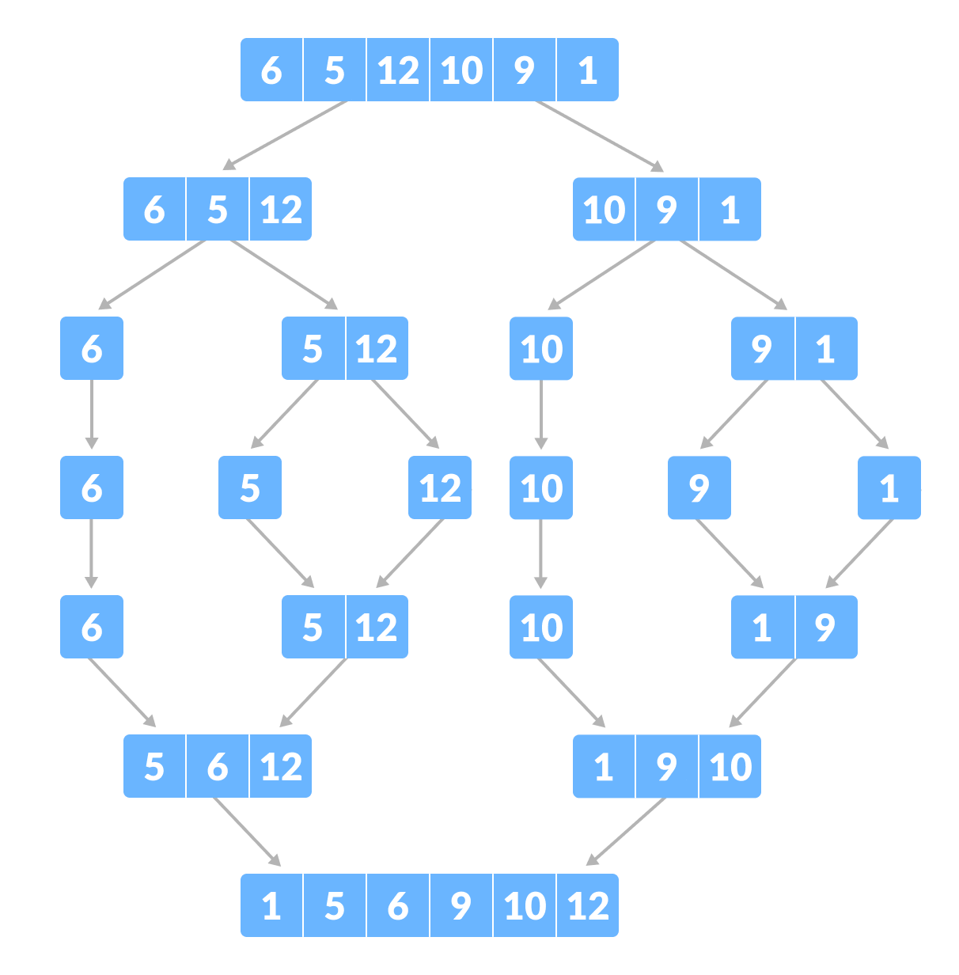
Example Of Merge Sort:

Slide 21
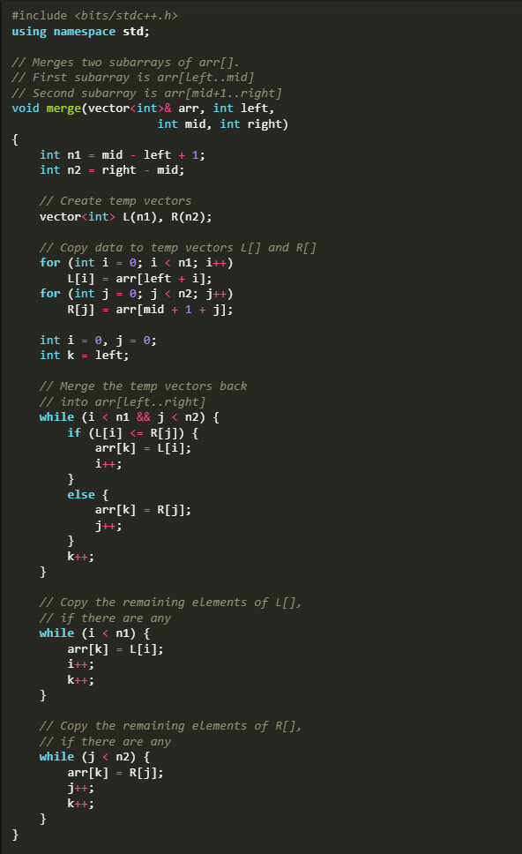
Implementation of Merge Sort:

Slide 22
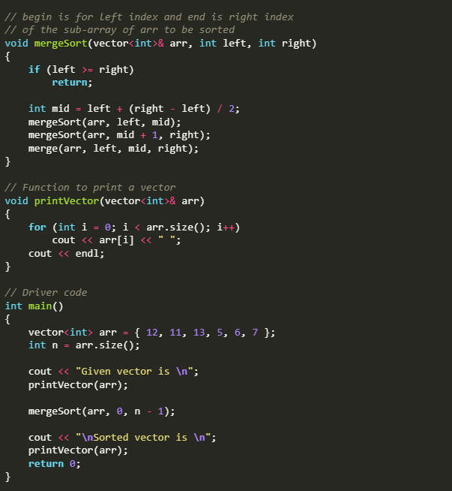

Slide 23

HEAP SORT

Slide 24
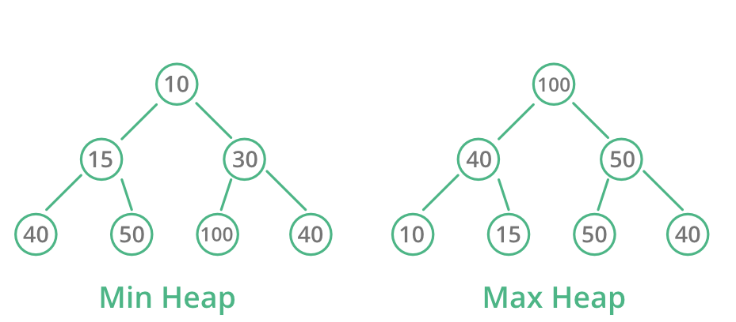
Definition : Heap Sort is a comparison-based sorting algorithm that uses a binary heap data structure. It builds a heap from the input data and then repeatedly extracts the maximum (or minimum) element from the heap, placing it in the correct position in the sorted array. The process involves two main phases: building a max-heap (or min-heap) and then sorting the elements by swapping and re-adjusting the heap.

Slide 25
Key Concepts
1. Binary Heap:
Max-Heap: A binary heap where the parent node is always greater than or equal to its children.
Min-Heap: A binary heap where the parent node is always smaller than or equal to its children.
2. Heap Property:
In a max-heap, every parent node's value is greater than or equal to the values of its children.
In a min-heap, every parent node's value is smaller than or equal to the values of its children.
3.Heapify:
Heapify is the process of converting a binary tree into a heap. It ensures that the subtree rooted at a given node maintains the heap property.
Max-Heapify: Ensures the subtree is a max-heap.
Min-Heapify: Ensures the subtree is a min-heap.
4. Building the Heap:
Convert the array into a heap by calling heapify on all non-leaf nodes, starting from the last non-leaf node up to the root.
This process is called heap construction and takes O(n) time.

Slide 26
5. Extracting the Maximum/Minimum:
In a max-heap, the maximum element is always at the root. In a min-heap, the minimum element is at the root.
Swap the root with the last element of the heap, then reduce the size of the heap by one and call heapify on the root to restore the heap property.
6. Sorting Process:
After building the heap, repeatedly extract the maximum (or minimum) element and place it at the end of the array.
The array is sorted when all elements have been extracted, resulting in a sorted array in increasing (for max-heap) or decreasing (for min-heap) order.
7. Time Complexity:
Best, Average, Worst Case: O(n log n)
The time complexity is the same for all cases because the heap construction takes O(n) time, and extracting the maximum or minimum element n times takes O(n log n) time.
8. Space Complexity:
O(1) for in-place sorting as it does not require any additional memory apart from the input array.

Slide 27
9. Stability:
Heap sort is not a stable sort, meaning that the relative order of equal elements may not be preserved.
10. Use Cases:
Suitable for large data sets where in-place sorting is required, and stability is not a concern. Often used in scenarios like priority queues.

Slide 28
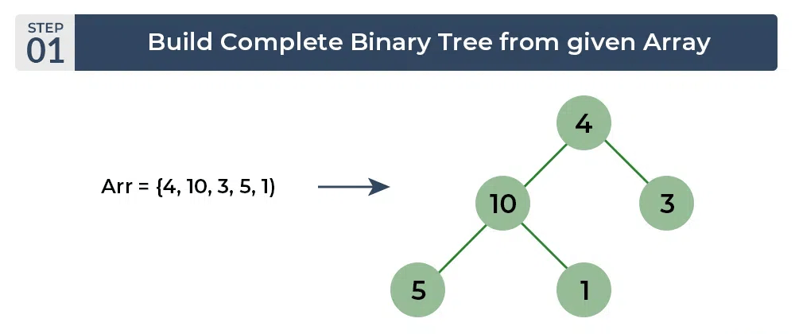
Example of Heap Sort

Slide 29
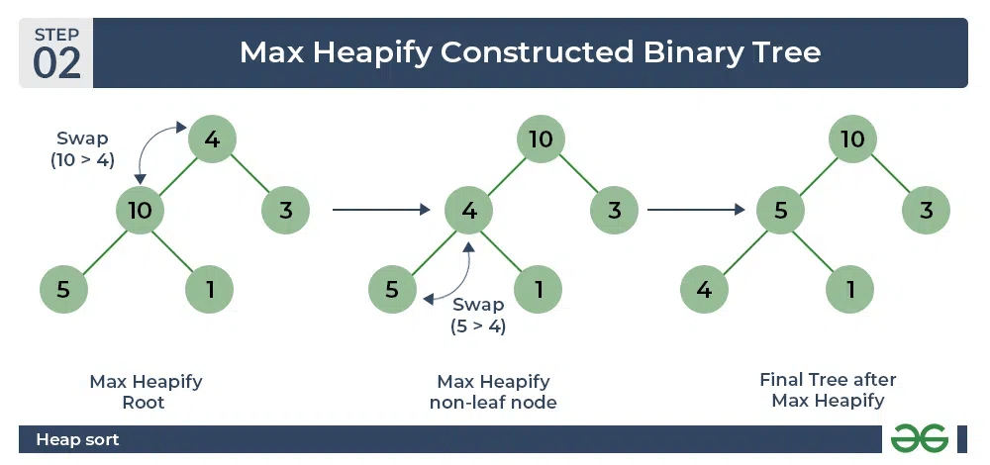

Slide 30
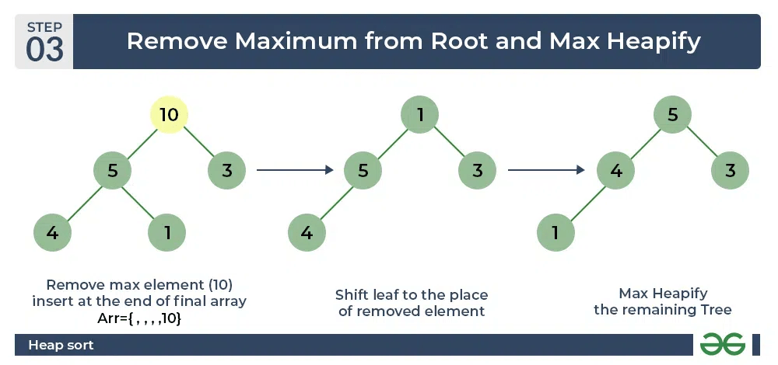

Slide 31
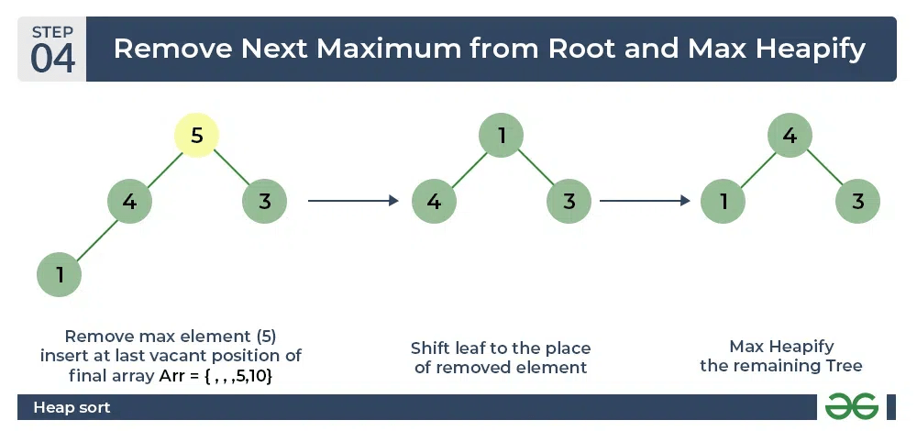

Slide 32
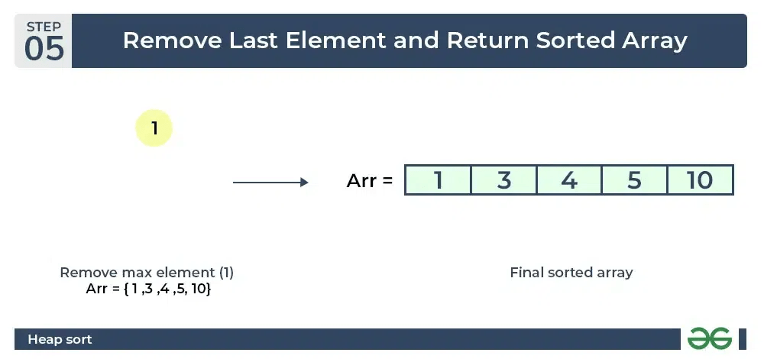

Slide 33
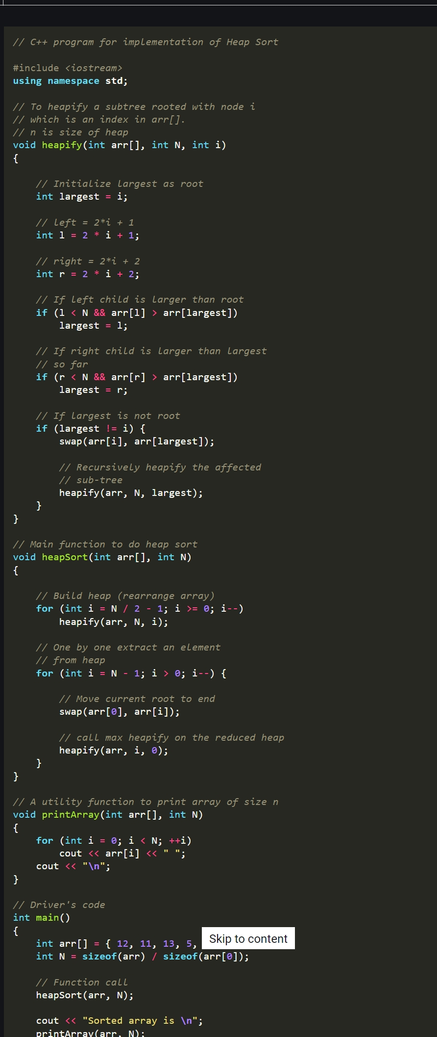
ALGORITHM OF HEAP SORT

Slide 34
THANK
YOU
GROUP MEMBERS:
22BSCS09 22BSCS10 22BSCS11 22BSCS56

